Slide 1
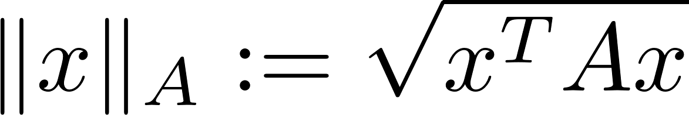
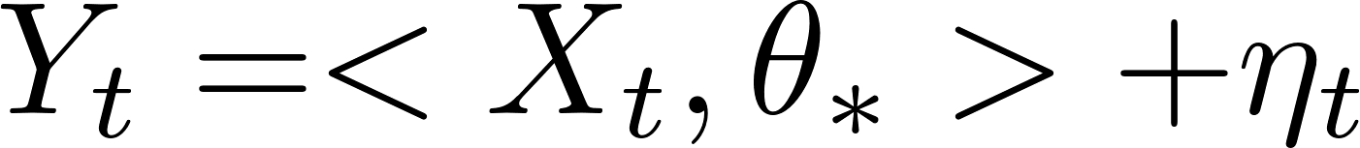
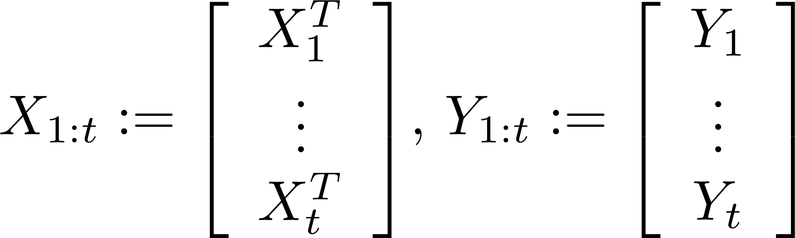
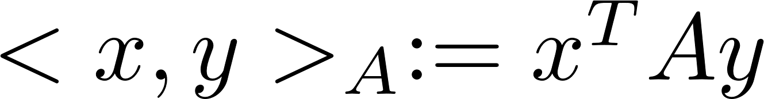
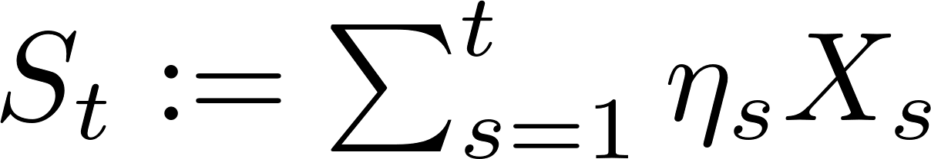
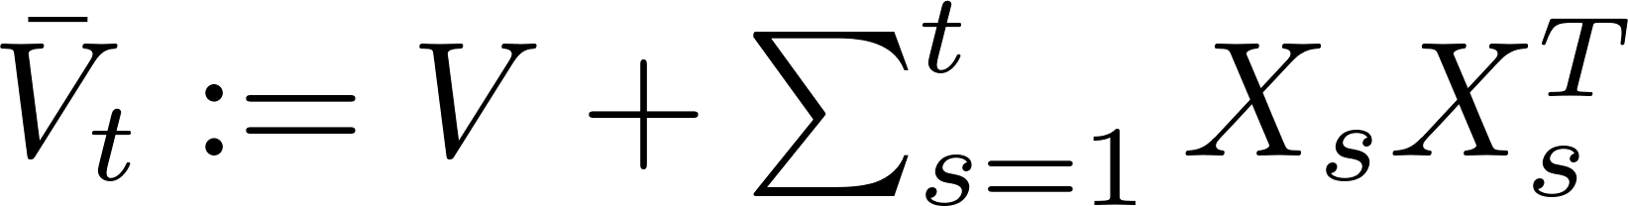

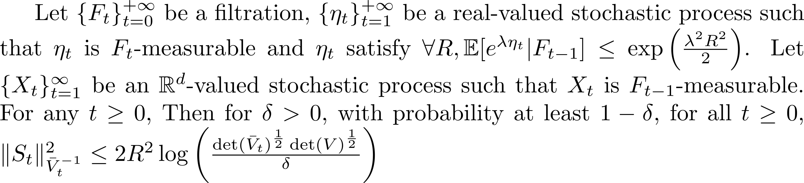
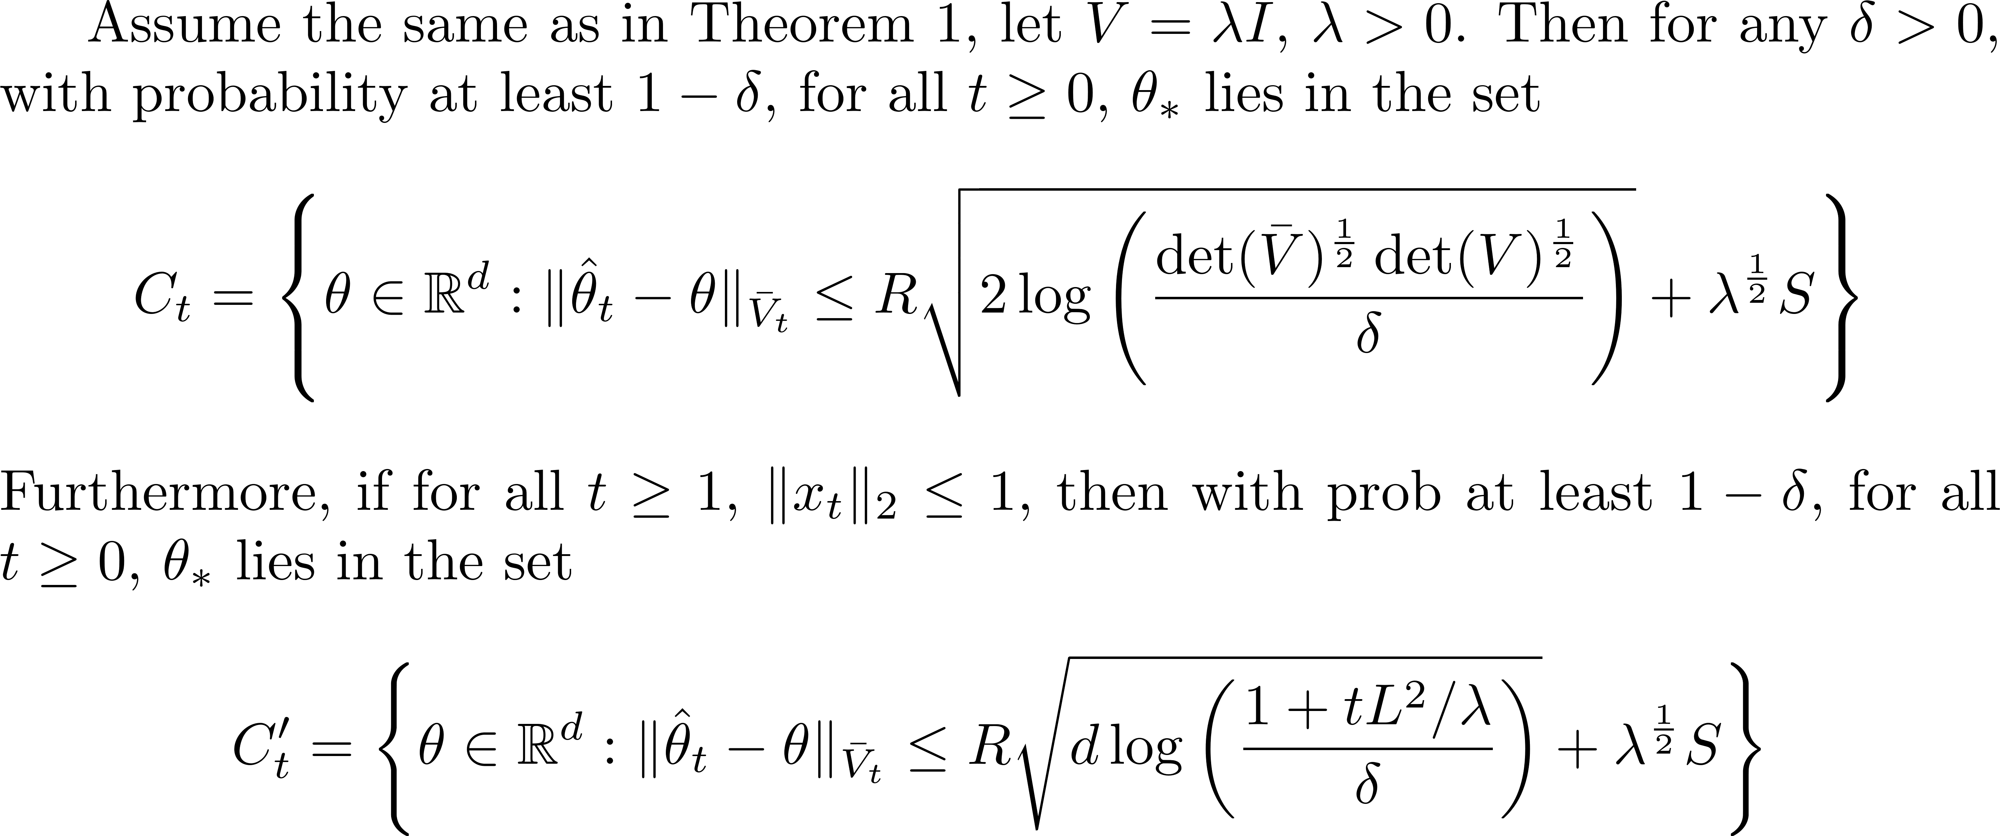
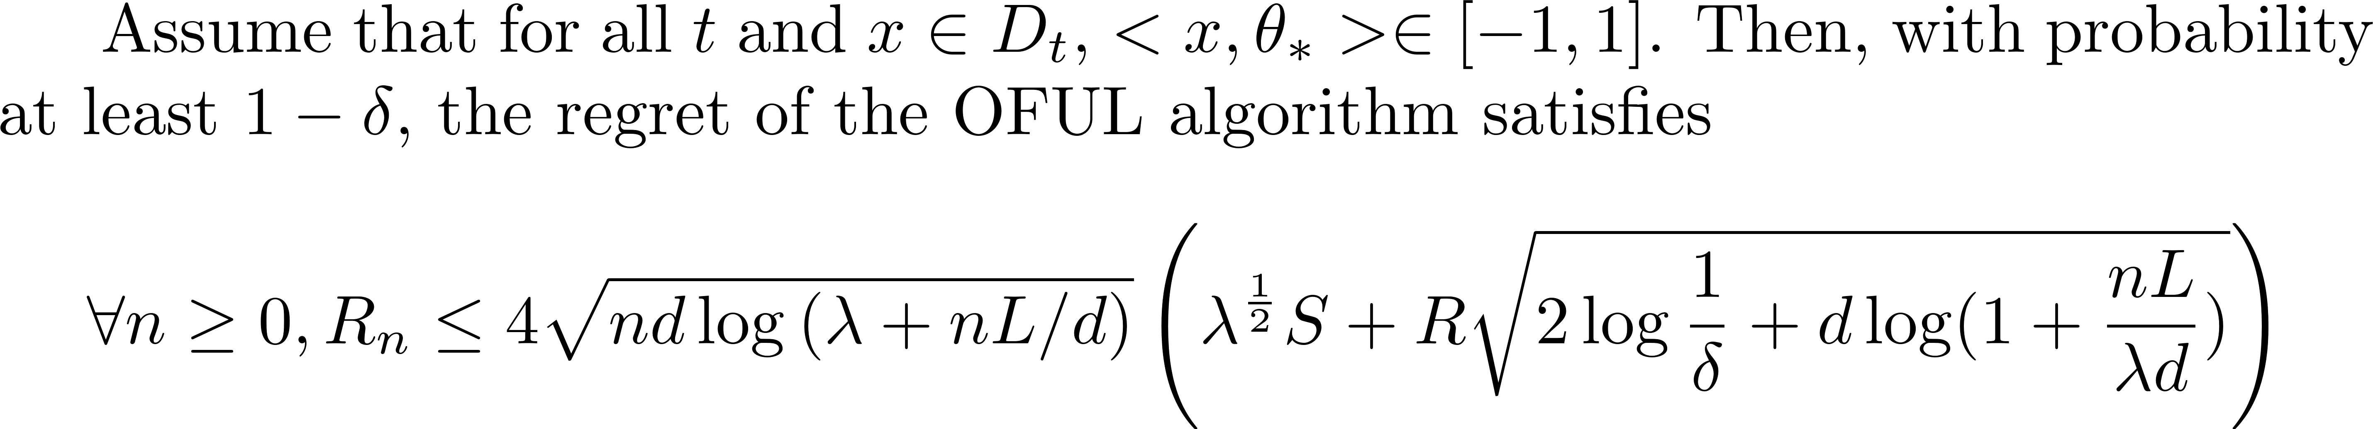
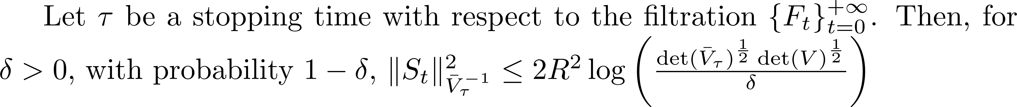
Some Definitions and Notations
V is positive semi-definite
Theorem 1, self-Normalized Bound
Theorem 2, Confidence Ellipsoid
Theorem 3, The regret bound of the OFUL algorithm
Lemma 9
Lemma 8
Lemma 10

Slide 2
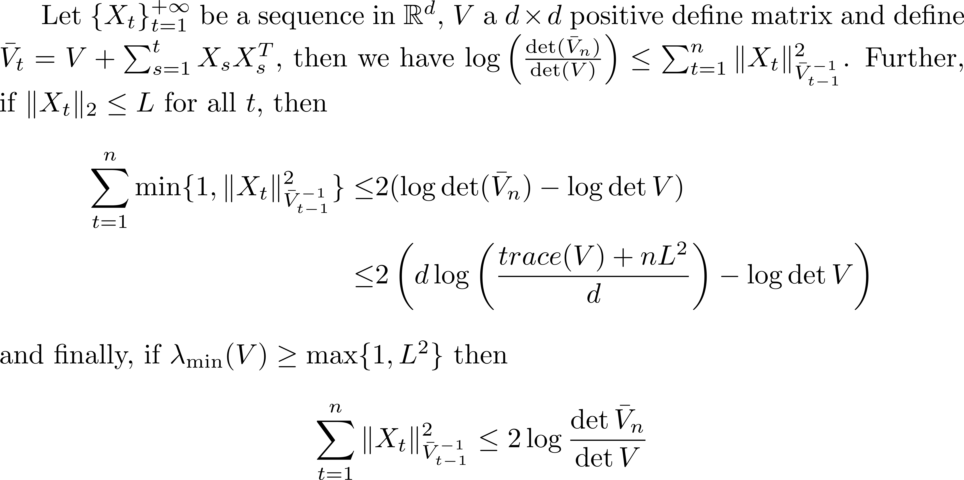
Lemma 8
Lemma 10
Lemma 9
Theorem 2, Confidence Ellipsoid
Theorem 1, self-Normalized Bound
Lemma 11
Theorem 3, The regret bound of the OFUL algorithm

